Slide 1

Examining Racial Discrimination Index and Black-Years of Potential Life Lost (YPLL) in South Carolina: A Real-Time Social Media Research
CHQ Weekly Seminar, Mar 29, 2024
Presenter: Yunqing Ma
Advisors: Drs. Peiyin Hung, Jiajia Zhang
Notes:
Hi everyone, I am Yunqing. Today I am going to talk about my CHQ project: Examining Racial Discrimination Index and Black-Years of Potential Life Lost (YPLL) in South Carolina: A Real-Time Social Media Research. My advisors are Dr. Hung and Dr. Zhang.

Slide 2
Agenda
Introduction
Why Racism
Measures of Racism
Research Gaps
Research Objectives
Project 1
Study Flow
Project 2
Study Design
Methods
Results
Main Findings
Study Design
Methods
Results
Main Findings
Notes:
I will first present the introduction, and then introduce our two projects.

Slide 3
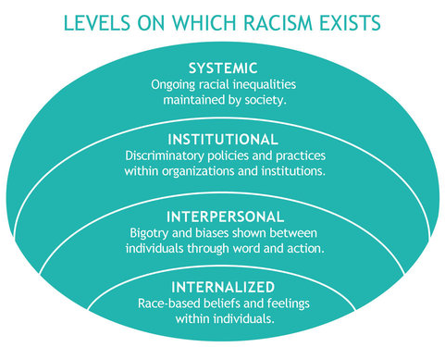


Why Racism
Over 35% of Americans identify as members of racial minority groups (United States Census Bureau, 2022)
Some racial minority populations have persistently experienced adverse health outcomes (Karvonen, 2023; Cave, 2020; Alhusen, 2016)
United Way of Washtenaw County (2023).Centering Yourself: Levels of Racism. Available from: https://rb.gy/6hy85
Notes:
Nowadays, racial discrimination is a big problem that cannot be ignored. Over 35% of Americans identify as members of racial minority groups. While diversity is a strength, it’s important to note the challenges that racial and ethnic minorities face. Some racial minority populations have persistently experienced adverse health outcomes. Racism has its levels. From the right figure, we can see there are four levels of racism, including systemic, institutional, interpersonal, and internalized racism.

Slide 4
Racism has been considered as one key contributor fueling health disparities.
Racial discriminations elicit a lack of access to resources and opportunities, such as quality education, workforce participation, housing, healthy food options, and culturally competent social services (Schillinger, 2020)
The scarcity of resources that promote health, combined with discrimination entrenched in some communities within the society, significantly impedes the ability of racially marginalized individuals to engage in healthy behaviors, further perpetuating Black-white disparities in health outcomes (Jin et al., 2020; Lewer et al., 2020).
Notes:
Many references presented that racism has been considered as one key contributor fueling health disparities. Racial discrimination leads to unequal access to essential resources like education, jobs, housing, and health services. This scarcity of resources exacerbates health disparities between Black and white communities, as marginalized individuals face barriers to adopting healthy behaviors.

Slide 5
Yet, racism metrics mostly rely on outdated ecological data.
Prior study relied on social demographics:
Racial residential segregation (Braveman et al., 2022)
Black-to-White ratios of education attainment, employment, and incarceration (Chantarat et al., 2022; Groos et al., 2018)
These measures have been challenged.
Inability to capture multi-level (e.g., institutional operations and interpersonal discriminatory behaviors) and multi-dimensional (e.g., segregation, wealth, and education) racism (Liu et al., 2019).
Notes:
Although racism is quite a huge issue, racism metrics mostly rely on outdated ecological data. Some measures of racism relied on social demographics, such as Racial residential segregation, and Black-to-White ratios of education attainment, employment, and incarceration. These measures have disadvantages. They are not able to capture multi-level racism, such as institutional operations and interpersonal discriminatory behaviors. They cannot measure multi-dimensional racism neither, such as segregation, wealth, and education.

Slide 6
Research Gaps
Limited focus on developing measures for studying racism at the interpersonal level.
Limited research using social media data to explore the complexities of racism.
The conceptualization and operationalization of racism have been heavily relying on self-reported perceived discrimination or historical structural factors.
Notes:
Thus, for the research gaps, we have Limited focus on developing measures for studying racism at the interpersonal level, Limited research using social media data to explore the complexities of racism. And also, The conceptualization and operationalization of racism have been heavily relying on self-reported perceived discrimination or historical structural factors.

Slide 7
Research Objectives
Project 1: To develop and investigate racism index using real-time social media data and machine learning techniques
Project 2: To test whether developed racism index was associated with health outcome – starting from Years of Potential Life Lost among Black populations
Notes:
To fill these gaps, we did two projects. For the first project, our objectives were to develop and investigate racism index using real-time social media data and machine learning techniques. For the second project, we further tested whether developed racism index was associated with health outcome – starting from Years of Potential Life Lost among Black populations.

Slide 8



Project 1
Identify messages on Twitter that contain racist or discriminatory content
Develop a new racism measure
Investigate the geospatial distributions in real-time racism
Notes:
There are three main procedures for the first project to develop and investigate the racism index. First, we identified messages on Twitter that contain racist or discriminatory content. Then, we developed a new racism measure. After this, we investigated the geospatial distributions in real-time racism.

Slide 9
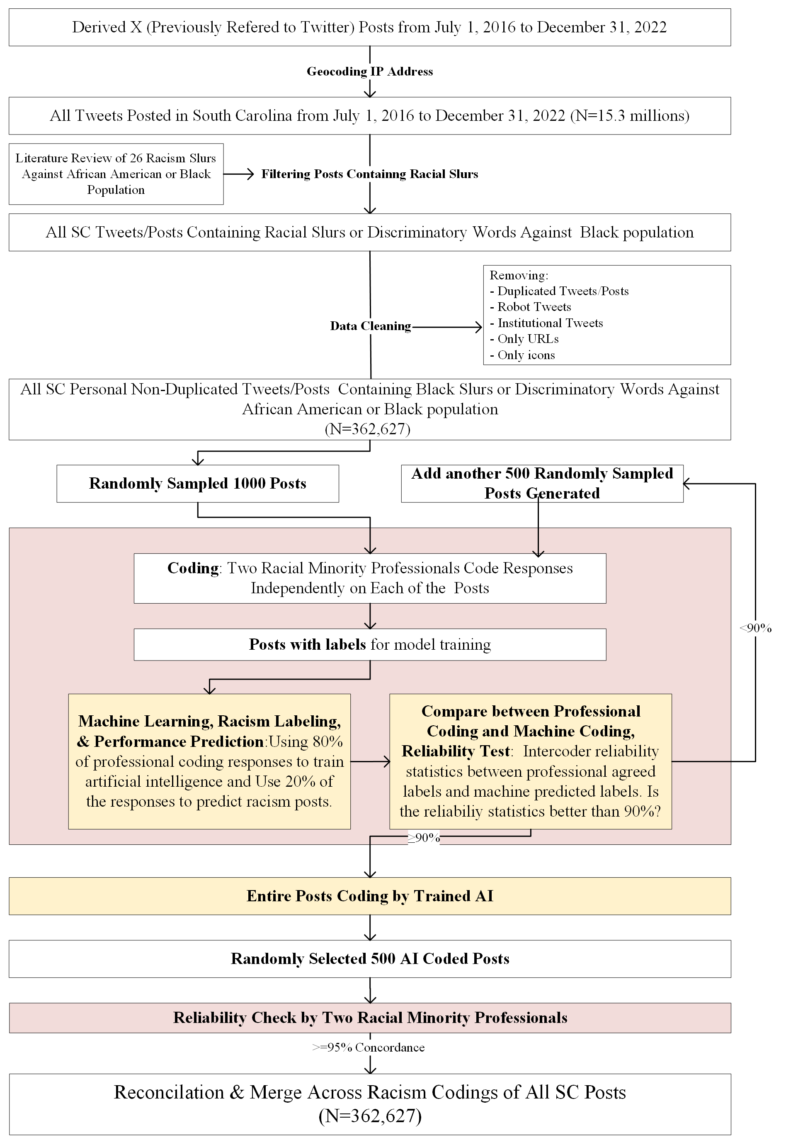
Study Flow
Notes:
Here is the study flow chart. For some of the main parts, I will discuss in detail. First, we derived twitter posts from July 2016 to December 2022 with their IP address. Using 26 racism slurs, words or phrases, we narrowed down to the posts containing discriminatory words against Black population. Then, we did the data cleaning, and got over 362 thousand posts left. Sometimes, a tweet will contain a joke or type of self-deprecation among black people, or a tweet can probably message an endearment among the black community. So, after the data steps, we trained AI with supervision to label the posts that contain discriminatory remarks. We randomly sampled 1,000 posts and two racial minority professionals labeled these posts. We separated the data into a train set and a test set. If the test accuracy is below 90%, we would add another 500 random posts and redo all the procedures to make the AI model more accurate. After the accuracy reached 90%, we applied the model to label all the twitter posts.

Slide 10
Method – Study Design
Data Source:
Tweets posted on Twitter from January 1, 2018 to December 31, 2022 in South Carolina.
N=11,562,191 messages extracted from X/Twitter.
Rough Filter:
Use Black slurs references to roughly filter the Twitter data
A total of 26 words/phrases were identified from systematic literature review
Assume all discriminatory messages were included
n=362,627 messages containing potential racism expressions
Notes:
For the data step, the total number of the posts were over 11 million. After the rough filter using discriminatory words from the literature, we got over 362 thousand posts.

Slide 11
Method – Sample Tweets
Attributes: tweetID, userID, username, postdate, message, longitude, latitude
tweetid | userid | username | postdate | message
1143643142673092610 | 4221816688 | suprslimey | 2019-06-25 18:12:27 | i cannot believe someone would go so far as to put lotion in the microwave to beat off 😭😭😭😭😭😭😭😭😭😭😭 nigga i cannot
1143643340207996929 | 27811206 | JamieSessions | 2019-06-25 18:13:14 | This list was pretty much my grail when seeking out non FMW tapes/DVDs in high school. Check it out and seek out anything that you may not have seen. All of this is top quality stuff.
1143643371417821189 | 16151881 | imarajones | 2019-06-25 18:13:22 | @BorisOgun @1upmovement @tariqnasheed @freedomrideblog @theGrio @NYWomensFdn @translashmedia We’re talking about Black trans women. Stay on message.
1143643471313612801 | 405538460 | Becool088 | 2019-06-25 18:13:46 | @welikekittens So sorry for your loss R.I.P.Oreo🌈💔😪🙏🏼🌈 https://t.co/SdH8Lc5f0P
1143644333897342985 | 83352713 | MilePosts | 2019-06-25 18:17:11 | @JWLevitt @BrokenArrowCA @NikeTrail @NathanSportsInc @HeartbreakRunCo @drymaxsocks @Rocktape Congrats on your race! Loved seeing all your pics ❤️
1143644852632072192 | 4858412531 | _jaySpitta | 2019-06-25 18:19:15 | I sent my ex boyfriend new gf screenshots of what this nigga sent me LAST week. Talking about leaving her right this second and I’m here to update y’all... She stayed with him😂😂😂😂
1143645318950608897 | 221859991 | thatboy_bre | 2019-06-25 18:21:06 | @ilahi__ Nigga I KNOW you fuckin lyin!
1143645560060162050 | 25577093 | BradFowler11 | 2019-06-25 18:22:04 | @HobbyConnector I need that 9/11 paper! If I win I'll pay it forward with a couple of the items! If I lose; I need to talk with the winner haha!
1143645626191818752 | 16151881 | imarajones | 2019-06-25 18:22:19 | @laurazeal1 @freespeechtv @thelastsipnews The people enacting white supremacy are the people killing Black trans women.
1143645746392158209 | 34032284 | nishalamonte | 2019-06-25 18:22:48 | @LoSkii_13 Now he just like another dirty red nigga 😩😔🤦🏻‍♀️
Notes:
Here are some sample posts.

Slide 12
Method – AI Approach (BERT)
Bidirectional Encoder Representations from Transformers (BERT)
Architecture: BERT uses only the Encoder part of the original Transformer model.
Directionality: BERT is bidirectional, meaning it processes words in relation to all the other words that come before and after them in a sequence. This allows it to capture a rich understanding of word context and semantics.
Notes:
The AI model we used is called BERT, Bidirectional Encoder Representations from Transformers. It allows us to encode sentences to numeric vectors and detect the relations between each word. Since it is bidirectional, it can capture a rich understanding of word context and semantics.

Slide 13
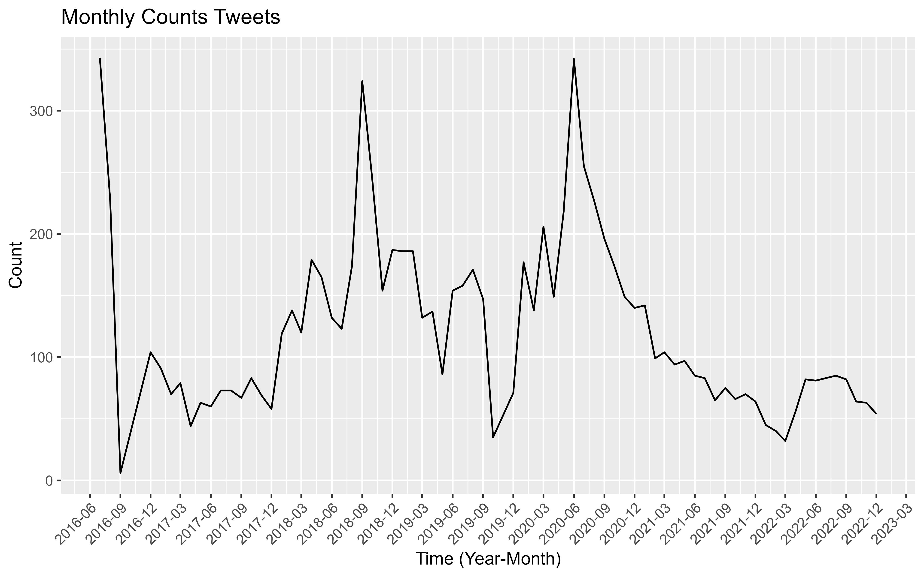
Results – Monthly Racial Posts
Notes:
After we trained the model and labeled all the 362 thousand posts, we got a monthly racial posts figure. The y-axis is the number of racial posts every month.

Slide 14
Results – Monthly Racial Posts
The Black Lives Matter Movement shook the world in June 2020.
The death of Botham Jean shot by a white police at his own home
Notes:
There are two peaks. First, on September 6, 2018, 26-year-old accountant Botham Jean was murdered in Dallas, Texas by an off-duty Dallas Police Department patrol officer. The second peak was in June 2020. The Black Lives Matter Movement shook the world in June 2020. These two peaks reflect that our measures can capture the hotly discussed discriminatory incidents in society.

Slide 15
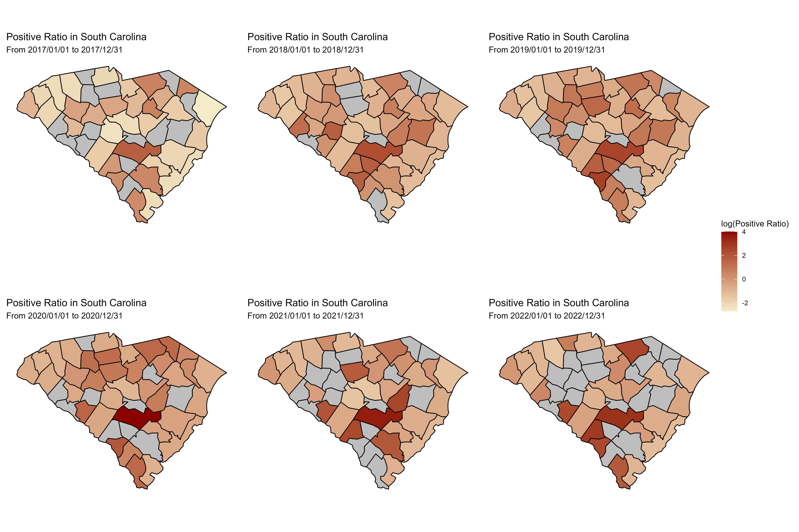
Results – Yearly Racial Discrimination Index by County
Racial Discrimination Index: the racial discrimination ratio per 100,000 posts for each county in each year.
Notes:
We also developed a racial discrimination index. It is calculated by the number of posts per 100,000 posts for each county each year. Combining with the geographic information of the posts, we were able to present the spatial-temporal development of racial discrimination. From the plot, we can see that in general, the racial discrimination index is increasing in some of the counties in South Carolina.

Slide 16
Results – Tercile Tweeter Racism Scores
 | Tercile Tweeter Racism Scores |  |  |  | Tercile Tweeter Racism Scores
 | 01/01/2017-12/31/2017 |  |  |  | 01/01/2022-12/31/2022
 | Tercile I | Tercile II | Tercile III | P-values | Tercile I | Tercile II | Tercile III | P-values
Number of Counties | 10 | 11 | 11 |  | 9 | 9 | 9
Positive Ratio, Min-Max | 0.071-0.134 | 0.134-0.470 | 0.494-5.580 |  | 0.217-0.398 | 0.444-0.981 | 1.403-20.925
Positive Ratio, Mean (SD) | 0.111 (0.019) | 0.250 (0.110) | 1.630 (1.400) |  | 0.342 (0.058) | 0.647 (0.181) | 9.328 (7.016)
County Mean Age
%65+ | 16.821 (4.410) | 18.046 (2.823) | 18.602 (0.452) | 0.364 | 19.645 (4.576) | 18.446 (3.753) | 19.877 (1.464) | 0.807
Gender
%Female | 51.153 (0.594) | 51.774 (0.890) | 51.068 (2.238) | 0.868 | 51.809 (0.620) | 51.449 (0.814) | 50.767 (1.979) | 0.092
Race/Ethnicity
%White | 72.546 (11.455) | 67.756 (15.176) | 52.052 (24.757) | 0.091 | 68.514 (8.206) | 63.973 (15.863) | 49.664 (23.281) | 0.106
% Black | 21.016 (10.820) | 27.523 (15.358) | 43.111 (26.548) | 0.058 | 20.097 (9.297) | 24.430 (16.464) | 40.967 (26.993) | 0.109
County Location
% Rural | 22.299 (9.028) | 44.233 (14.542) | 70.211 (7.152) | <0.001 | 25.068 (9.814) | 35.406 (16.292) | 69.515 (8.205) | <0.001
Majority Rural Community
Yes | 0 | 3 | 11 |  | 0 | 1 | 9
No | 10 | 8 | 0 |  | 9 | 8 | 0
Data source:
American Community Surveys (ACS) data (Bureau, 2023) provided previously documented factors.
Notes:
We compared our racial discrimination index with some demographics. We separated the counties into three terciles. Each tercile includes around 10 counties and has its proportion of people that are over 65 years old, female, White, Black, and the proportion of land that were rural. We found only the county location is significantly related with the racial discrimination index.

Slide 17
Main Findings
The racism scores changed significantly. These changes align with historical indicators of structural racism.
July 7, 2016: The protests in Dallas were against police shootings of Philando Castile and Alton Sterling in other states.
September 12, 2018: Sacramento police shooting.
May 28, 2020: 8.8 million uses of #BlackLivesMatter as national and global protests spread.
The racial discrimination index (RDI) provides a more immediate and timely potential for racism, disparities, and inequity analysis.
This is the first study to report a relationship between a digital real-time racism score and multiple social determinants of health.
Notes:
From this project, there are several findings. The racism scores changed significantly. These changes align with historical indicators of structural racism, indicating our index is a good metric of measuring the racism. The racial discrimination index provides a more immediate and timely potential for racism, disparities, and inequity analysis. This is the first study to report a relationship between a digital real-time racism score and multiple social determinants of health.

Slide 18
Project 2
Examine the relationship between racism index and life expectancy among Black population in South Carolina
Notes:
Since we got the index, we are interested in the relationship between the index and some health outcomes. Thus, for the second project, we examine the relationship between racism index and life expectancy among Black population in South Carolina.

Slide 19
Method – Study Design
Data Source:
County-level racial discrimination index from January 1, 2018 to December 31, 2022 in South Carolina.
County-level Years of potential life lost (YPLL) rate for all 46 counties in South Carolina (SC) from 2018 to 2022 from County Health Rankings data.
American Community Surveys (ACS) data (Bureau, 2023) provided previously documented confounding factors for YPLL and racism.
Notes:
Here, we would like to discover the relationship between the years of potential life lost (YPLL) and our index. So far, we already got the index. And the county-level YPLL rate is from County Health Rankings data. We were also considering some previously documented confounders for YPLL and racism from the ACS data.

Slide 20
Method – Linear Mixed Effect Model
Unadjusted and multivariable linear mixed-effects models (LMMs) were used to examine the associations between various demographic and socioeconomic factors and the YPLL rate among Black populations.
All models controlled for county-level random effects using the FIPS code and yearly random effects.
Notes:
We used the linear mixed effect model to measure the relationship. Unadjusted and multivariable linear mixed-effects models (LMMs) were used to examine the associations between various demographic and socioeconomic factors and the YPLL rate among Black populations.

Slide 21
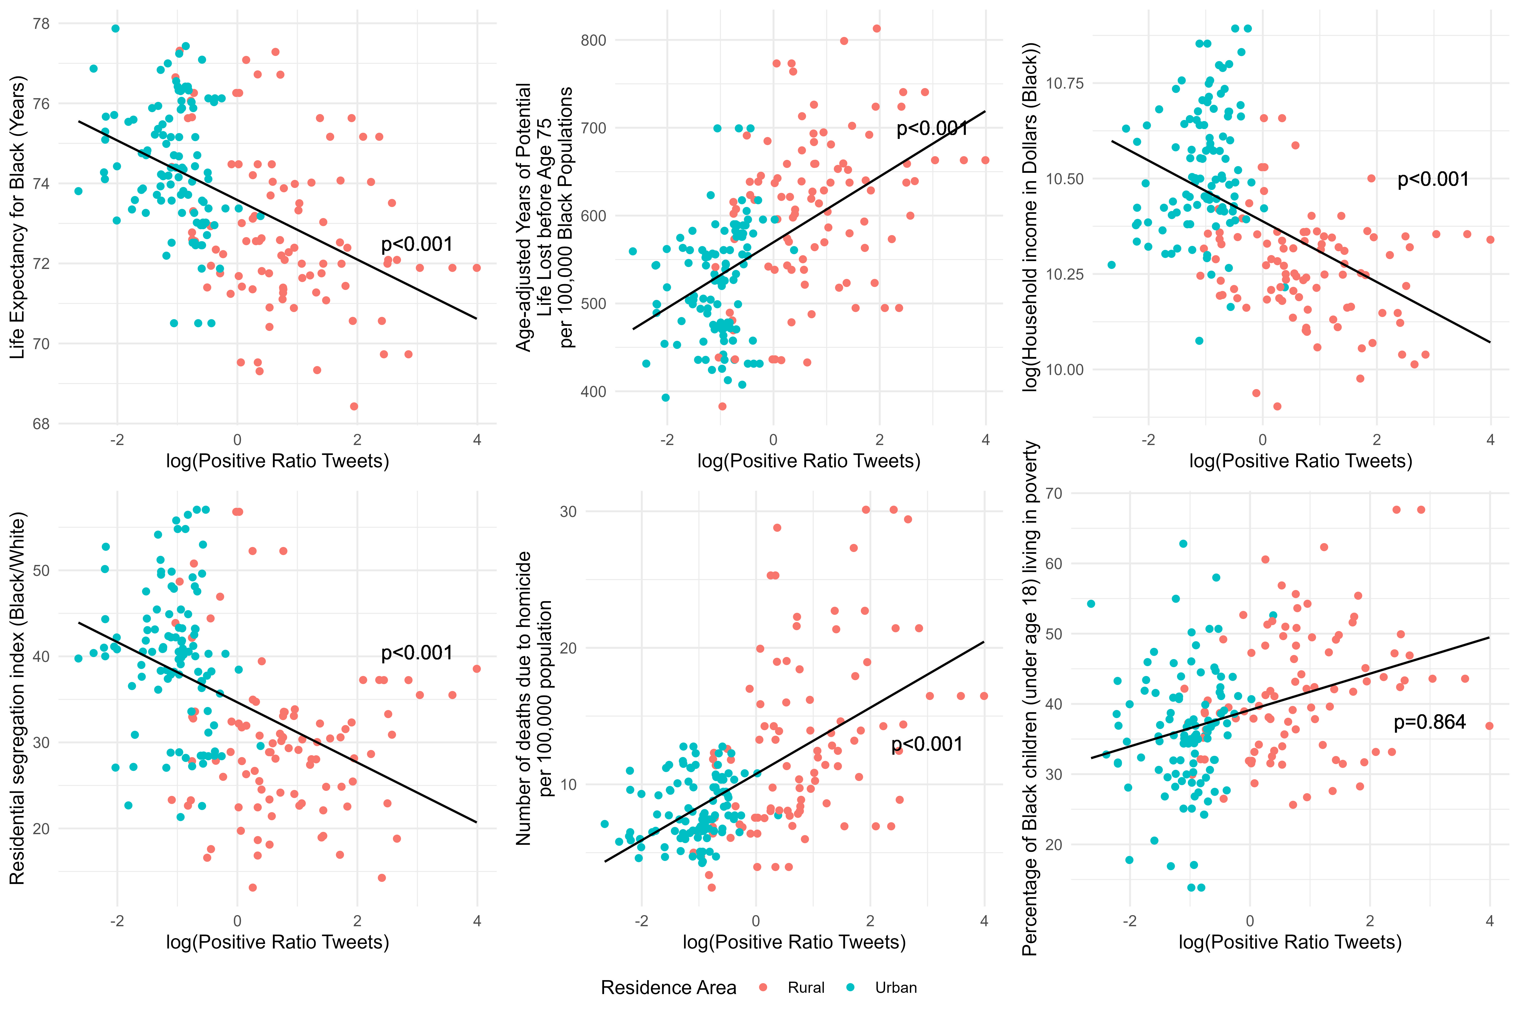
Results – Relations with Existing Index
Notes:
Before fitting the model, we did simple regression to see the crude relationship between our index and some common existing index. We can see from the plots that the relationship with life expectancy for Black, age-adjusted YPLL rate, log household income, residential segregation index, and number of deaths due to homicide were significant. The relationship with percentage of Black children living in poverty was not significant.

Slide 22
Results - Impact of Racial Discrimination Index on YPLL rates
Characteristics | Crude Model | Adjusted Model
logarithm of racial discrimination index | 679.54 (417.36, 942.49)* | 461.34 (132.06, 773.24)*
County-level Sociodemographic Characteristics (per 10 percentage)
% Female | 29.75 (-1.65, 61.78) | 47.51 (19.64, 74.71)*
% Living in a rural area | 4.39 (2.54, 6.25)* | 2.79 (-1.03, 6.17)
% Black | 5.86 (3.36, 8.33)* | -6.72 (-24.84, 12.67)
% Non-Hispanic White | -6.13 (-8.97, -3.30)* | -8.95 (-27.59, 10.94)
% Adults under age 65 without health insurance | 5.07 (-14.06, 24.28) | -3.58 (-21.75, 17.90)
% Unemployed adults aged 21 and over | 19.80 (6.69, 33.61)* | 18.36 (6.12, 30.80)*
% Adults aged 25 and over with a high school diploma or equivalent | 7.12 (2.88, 11.09)* | 2.95 (-3.99, 10.18)
Household Income for the Black (Unit: $1,000) | 33.31 (-53.39, 105.30) | 60.52 (-13.73, 121.11)
Coefficients for all covariates’ crude model were calculated without adjusting other covariates.
Notes:
After fitting the mixed model, we got this result table. From the model adjusting for demographics and socio-economic predictors, logarithm of positive ratio index, the percentage of population that is female, and that is unemployed were associated with an increasing YPLL.

Slide 23
Main Findings
Significant associations between this human-AI-collaborated racial discrimination index measure with
higher Black unemployment rates,
higher percentages of Black children living in poverty,
higher Black-White segregation index,
and lower Black Household income.
The racial discrimination index was associated with increased YPLL.
Notes:
We got our main findings for the second project. There are significant associations between this human-AI-collaborated racial discrimination index measure with these four predictors. Also, the racial discrimination index was associated with increased YPLL.

Slide 24
Discussions – Implications
Targeted interventions are urgently needed to address systemic racism and socio-economic disparities to improve health outcomes among Black communities.
Interventions must extend beyond traditional realms of systemic oppression to encompass digital spaces for timely interventions.
Social media data and AI technology have the potential to be viable tools for monitoring and addressing racial discrimination in real-time.
Leveraging innovative approaches developed and validated by this study can inform policymakers, public health officials, and researchers for more effective strategies to prevent racism-related consequences such as YPLL.
Notes:
From two projects I presented, there are several implications. Targeted interventions are urgently needed to address systemic racism and socio-economic disparities to improve health outcomes among Black communities. Interventions must extend beyond traditional realms of systemic oppression to encompass digital spaces for timely interventions. Social media data and AI technology have the potential to be viable tools for monitoring and addressing racial discrimination in real-time. Leveraging innovative approaches developed and validated by this study can inform policymakers, public health officials, and researchers for more effective strategies to prevent racism-related consequences such as YPLL.

Slide 25
Strengths and Limitations
Strengths
Limitations
Pioneer work identifying racial discrimination using social media, human coding, and AI techniques
Quantify racism and socioeconomic disparities in a rural Southern state, beyond traditional structural racism measures
Identify racism-associated YPLL
Lack of representativeness (reliance on documented racial slurs and phrases)
Lack of generalizability
Focus on one health outcome
Notes:
The study highlights the significant impact of racial discrimination on health outcomes among Black populations in South Carolina.
It emphasizes the role of structural racism and socioeconomic disparities in perpetuating health inequities among racially marginalized communities.
The study utilizes social media data and AI to capture real-time expressions of racial discrimination, extending beyond traditional measures of racism.
This approach offers a novel and comprehensive method for studying racism in contemporary society, complementing traditional research methods and providing a clearer understanding of its impact on health outcomes.
Issues of representativeness, including discriminatory remarks expressed using non-discriminatory terms and uneven posting behavior, complicate interpretation and generalizability.
The study's focus on South Carolina limits generalizability to other geographic regions, despite analyzing a substantial number of posts and undergoing multiple validation processes.
Future research should explore the methodology's applicability in diverse contexts and assess the effectiveness of interventions targeting racial discrimination and health outcomes among marginalized populations.

Slide 26
References
Banaji, M. R., Fiske, S. T., & Massey, D. S. (2021). Systemic racism: Individuals and interactions, institutions and society. Cognitive Research: Principles and Implications, 6, 82. https://doi.org/10.1186/s41235-021-00349-3
Braveman, P. A., Arkin, E., Proctor, D., Kauh, T., & Holm, N. (2022). Systemic And Structural Racism: Definitions, Examples, Health Damages, And Approaches To Dismantling. Health Affairs (Project Hope), 41(2), 171–178. https://doi.org/10.1377/hlthaff.2021.01394
Chantarat, T., Van Riper, D. C., & Hardeman, R. R. (2022). Multidimensional structural racism predicts birth outcomes for Black and White Minnesotans. Health Services Research, 57(3), 448–457. https://doi.org/10.1111/1475-6773.13976
Devlin, J., Chang, M.-W., Lee, K., & Toutanova, K. (2019). BERT: Pre-training of Deep Bidirectional Transformers for Language Understanding (arXiv:1810.04805). arXiv. https://doi.org/10.48550/arXiv.1810.04805
Dixon, S. (2023). Social media usage in the United States—Statistics & Facts. https://www.statista.com/topics/3196/social-media-usage-in-the-united-states/#topicOverview
Groos, M., Wallace, M., Hardeman, R., & Theall, K. P. (2018). Measuring inequity: A systematic review of methods used to quantify structural racism. 11(2).
Kornienko, O., Rambaran, J. A., & Rivas-Drake, D. (2022). Interpersonal racism and peer relationships: An integrative framework and directions for research. Journal of Applied Developmental Psychology, 80, 101414. https://doi.org/10.1016/j.appdev.2022.101414
Lawrence, H. P., Cidro, J., Isaac-Mann, S., Peressini, S., Maar, M., Schroth, R. J., Gordon, J. N., Hoffman-Goetz, L., Broughton, J. R., & Jamieson, L. (2016). Racism and Oral Health Outcomes among Pregnant Canadian Aboriginal Women. Journal of Health Care for the Poor and Underserved, 27(1), 178–206. https://doi.org/10.1353/hpu.2016.0030
Liu, S. Y., Fiorentini, C., Bailey, Z., Huynh, M., McVeigh, K., & Kaplan, D. (2019). Structural Racism and Severe Maternal Morbidity in New York State. Clinical Medicine Insights. Women’s Health, 12, 1179562X19854778. https://doi.org/10.1177/1179562X19854778
Paradies, Y. (2016). Colonisation, racism and indigenous health. Journal of Population Research, 33(1), 83–96. https://doi.org/10.1007/s12546-016-9159-y
Paradies, Y., Ben, J., Denson, N., Elias, A., Priest, N., Pieterse, A., Gupta, A., Kelaher, M., & Gee, G. (2015). Racism as a Determinant of Health: A Systematic Review and Meta-Analysis. PLOS ONE, 10(9), e0138511. https://doi.org/10.1371/journal.pone.0138511
Relia, K., Li, Z., Cook, S. H., & Chunara, R. (2019). Race, Ethnicity and National Origin-Based Discrimination in Social Media and Hate Crimes across 100 U.S. Cities. Proceedings of the International AAAI Conference on Web and Social Media, 13, 417–427. https://doi.org/10.1609/icwsm.v13i01.3354
United States Census Bureau. (2022). U.S. Census Bureau QuickFacts: United States. https://www.census.gov/quickfacts/fact/table/US/RHI125222#RHI125222
Cave L, Cooper MN, Zubrick SR, Shepherd CCJ. Racial discrimination and child and adolescent health in longitudinal studies: A systematic review. Soc Sci Med. 2020 Feb 27;250:112864. doi: 10.1016/j.socscimed.2020.112864. Epub ahead of print. PMID: 32143088.
Alhusen JL, Bower KM, Epstein E, Sharps P. Racial Discrimination and Adverse Birth Outcomes: An Integrative Review. J Midwifery Womens Health. 2016 Nov;61(6):707-720. doi: 10.1111/jmwh.12490. Epub 2016 Oct 13. PMID: 27737504; PMCID: PMC5206968.
Karvonen KA, Balay-Dustrude E, Do A, Bradford MC, Phipps A, Rosenberg AR. Race, ethnicity, and experienced racism are associated with adverse physical and mental health outcomes among cancer survivors. Cancer. 2023 Oct 1;129(19):3023-3033. doi: 10.1002/cncr.34913. Epub 2023 Jul 3. PMID: 37394987.

Slide 27
Thanks!
Yunqing Ma
Biostatistics PhD candidate
yunqing@email.sc.edu

